Slide 1
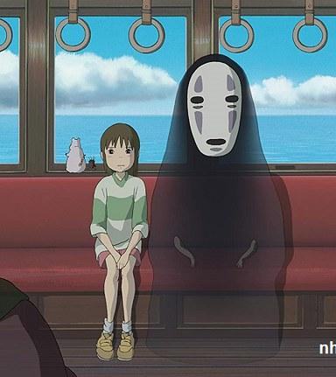
Anime
Recommendation -With Subtitles/Dialogue!
ML Project by
Kimberly M.

Slide 2

What Problem Do We Solve?

Slide 3



Inaccurate/Misleading Recommendations
Current anime enjoyers often need to know genre and studio ahead of time
This can lead to missing out on underrated series
Anime databases like MyAnimeList(MAL) and AniList often only describe series with quick blurbs and categories
Anime can have misleading series descriptions

Slide 4

Solution: Get Content From Dialogue!
Better recommend an anime based on actual dialogue and subtitle info
Instead of just metadata, user can get a recommendation from similar words and dialogue
Would prevent misleading blurbs or metadata
User don’t have to know category data ahead of time, they can describe what type of series they are thinking of watching

Slide 5
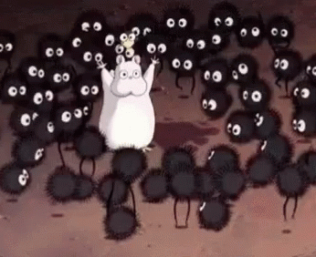
What is the ML approach used?

Slide 6

Dataset
Kaggle Anime Subtitles Dataset: Jess Fan
Picked this dataset due to it being preprocessed in json
Anime subtitles can comes in .ass and .srt formats with context and response fields
Anime titles are in the filenames of the json files
Anime titles in this case are anime name and the episode name
Not a lot of processing on our end

Slide 7
Machine Learning Models
Clustering:
K-Means(MiniBatchKMeans)
DBSCAN
Agglomerative Clustering(Hierarchical)
Natural Language Processing (NLP):
NLTK Techniques(Stop word removal, lemmatization)
TF-IDF Vectorization for text feature extraction.
Cosine Similarity and Pairwise Distances:
For recommendation and similarity matching.
Silhouette and Davies-Bouldin scores
To evaluate clustering quality.
Dimensionality Reduction via PCA and TruncatedSVD.

Slide 8
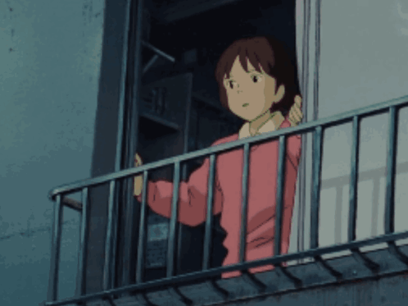
Let’s look at the results and Demo!

Slide 9
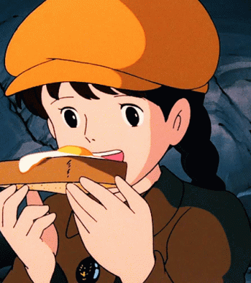
Thank You!

